Slide 1

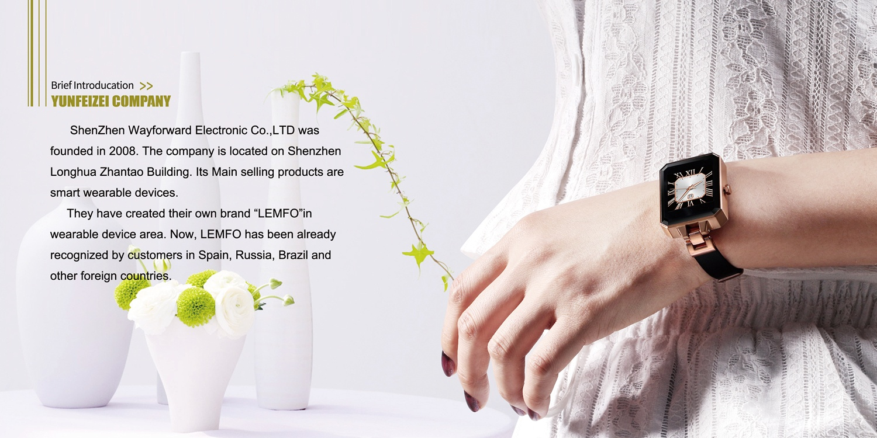
LEMFO SMART

Slide 2
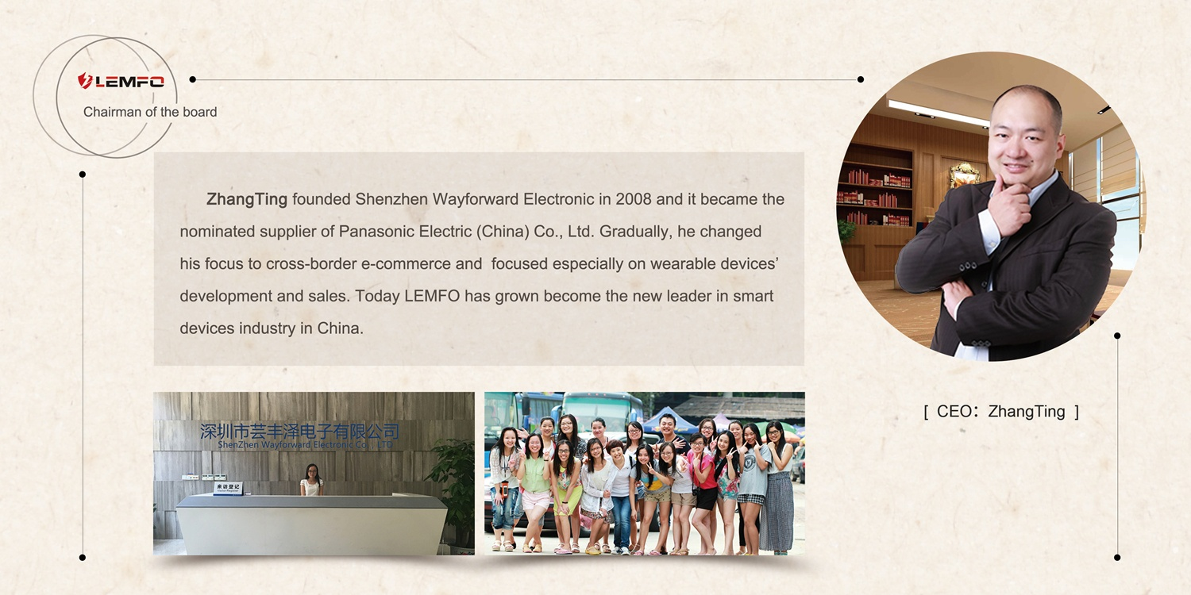
LEMFO SMART

Slide 3
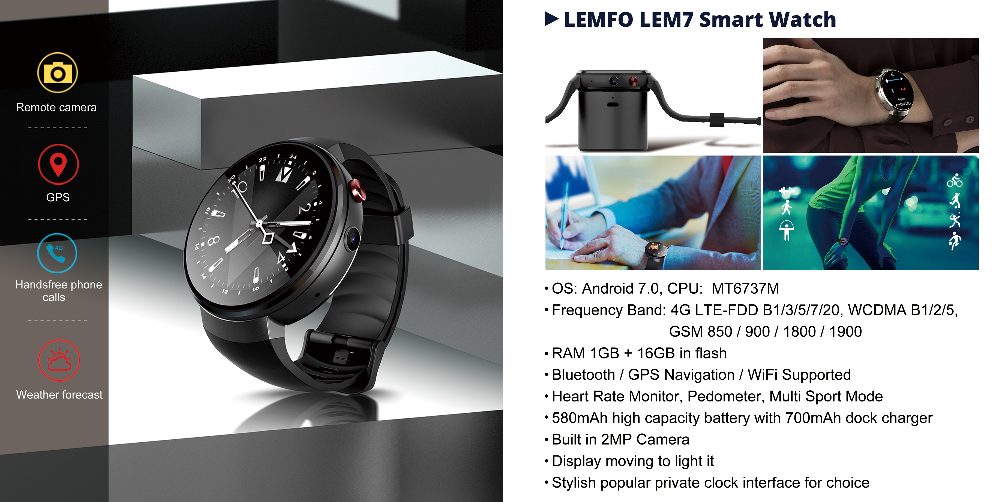
LEMFO SMART

Slide 4
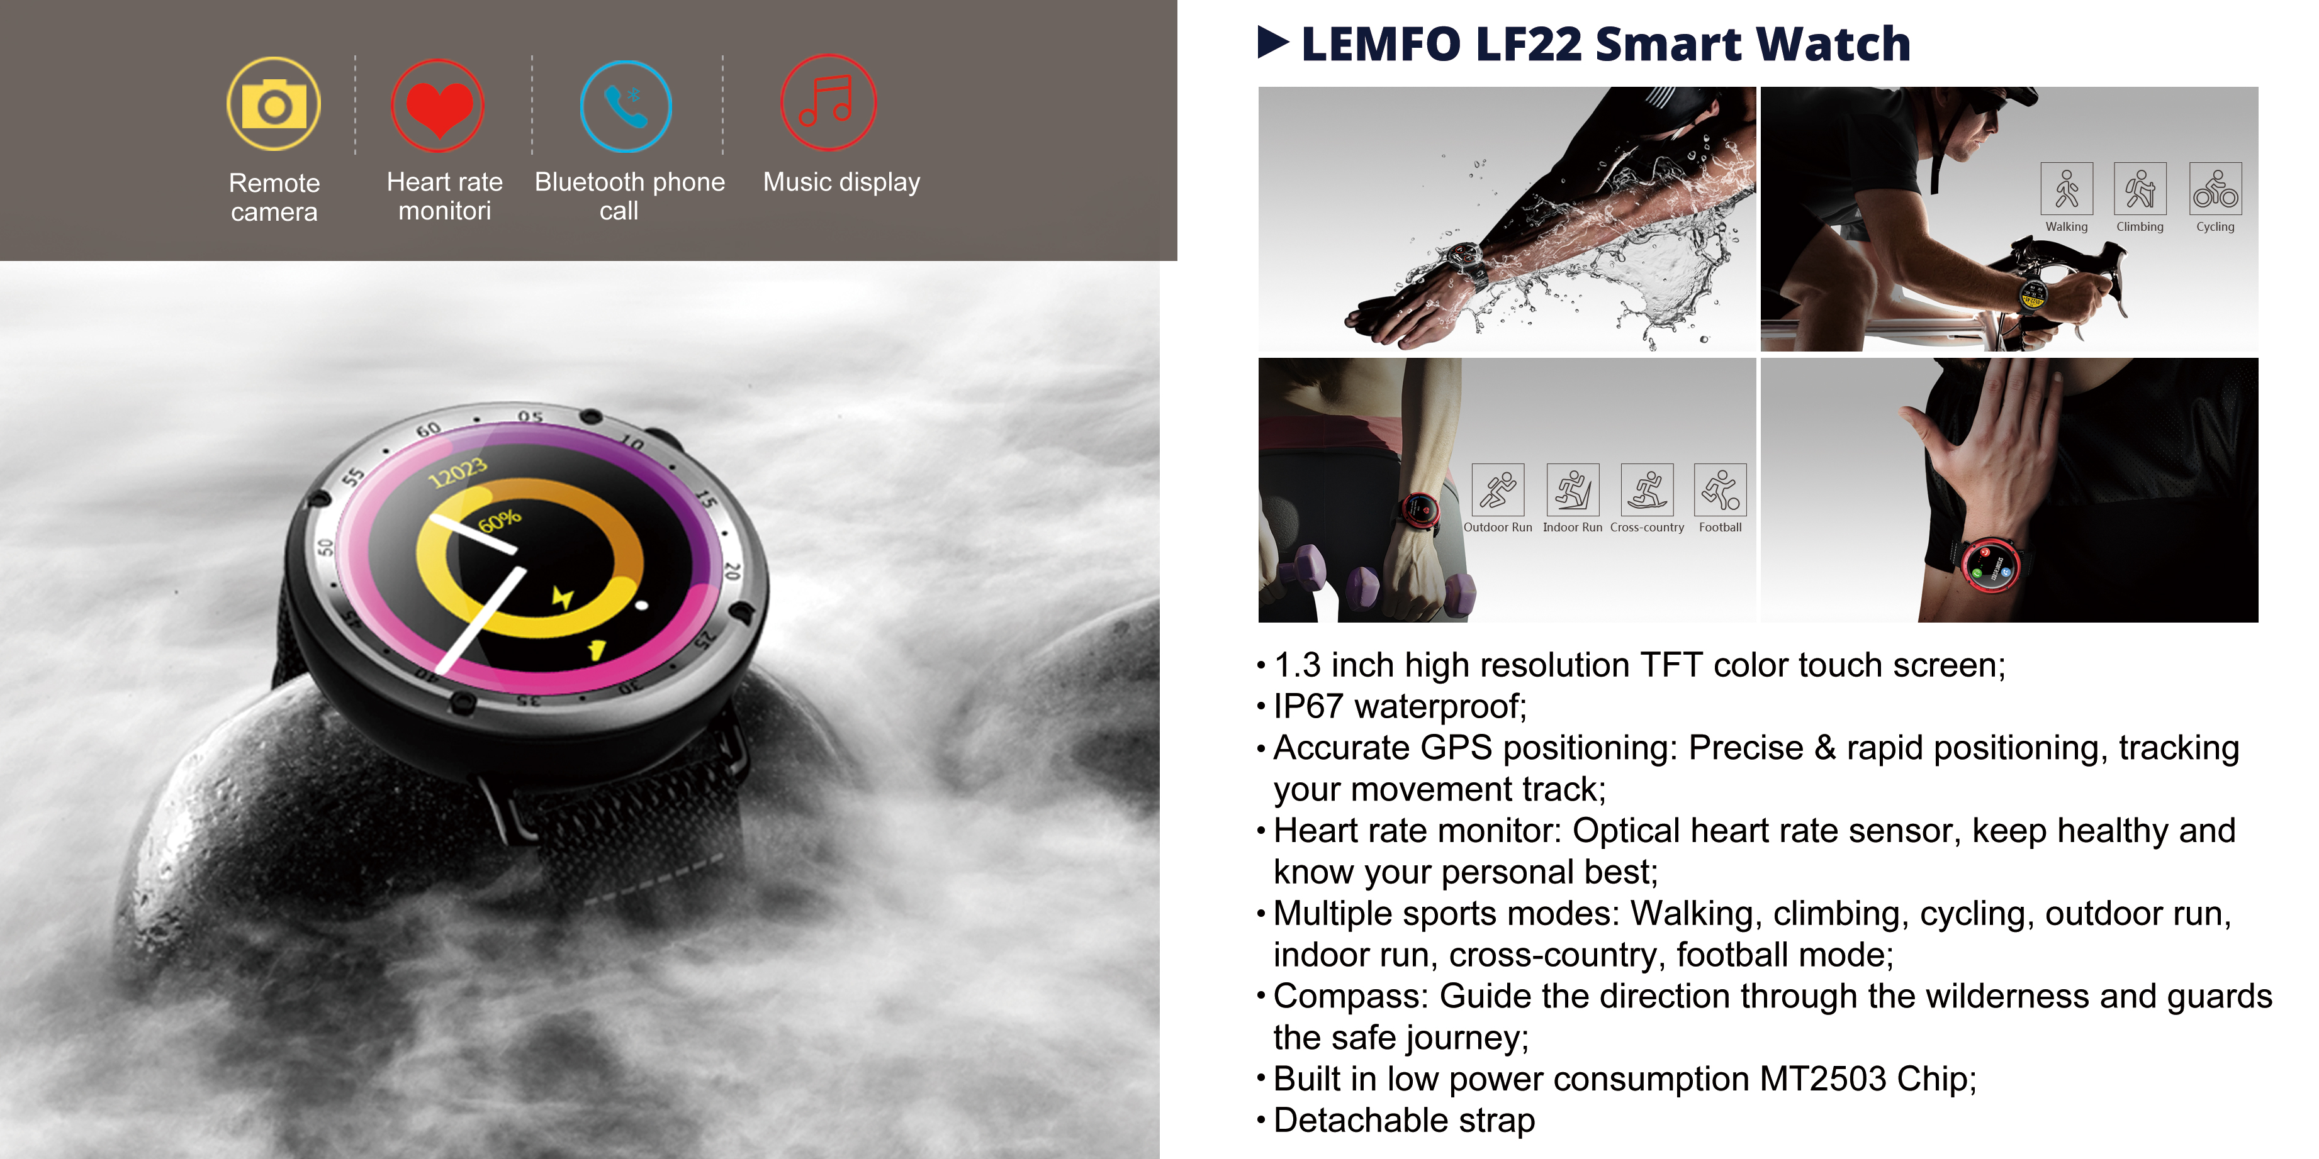
LEMFO SMART

Slide 5
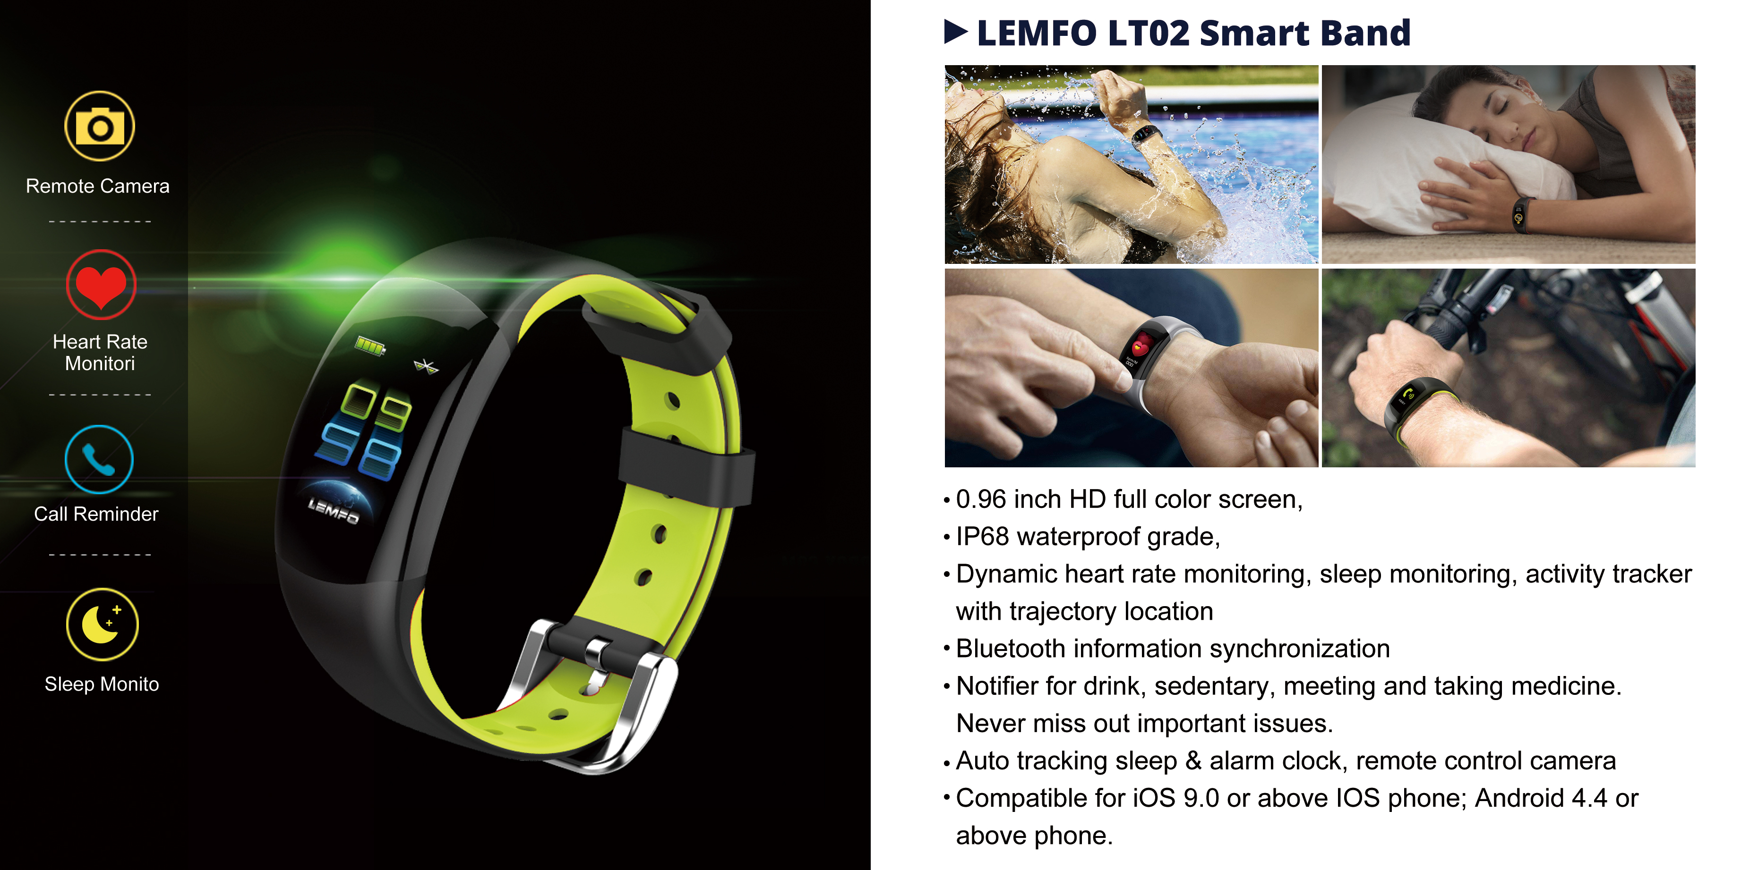
LEMFO SMART

Slide 6
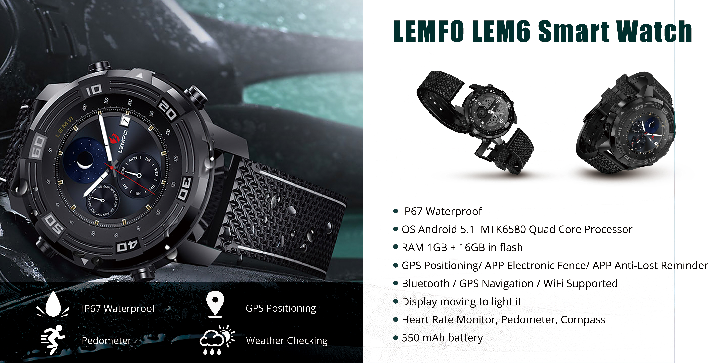
LEMFO SMART

Slide 7
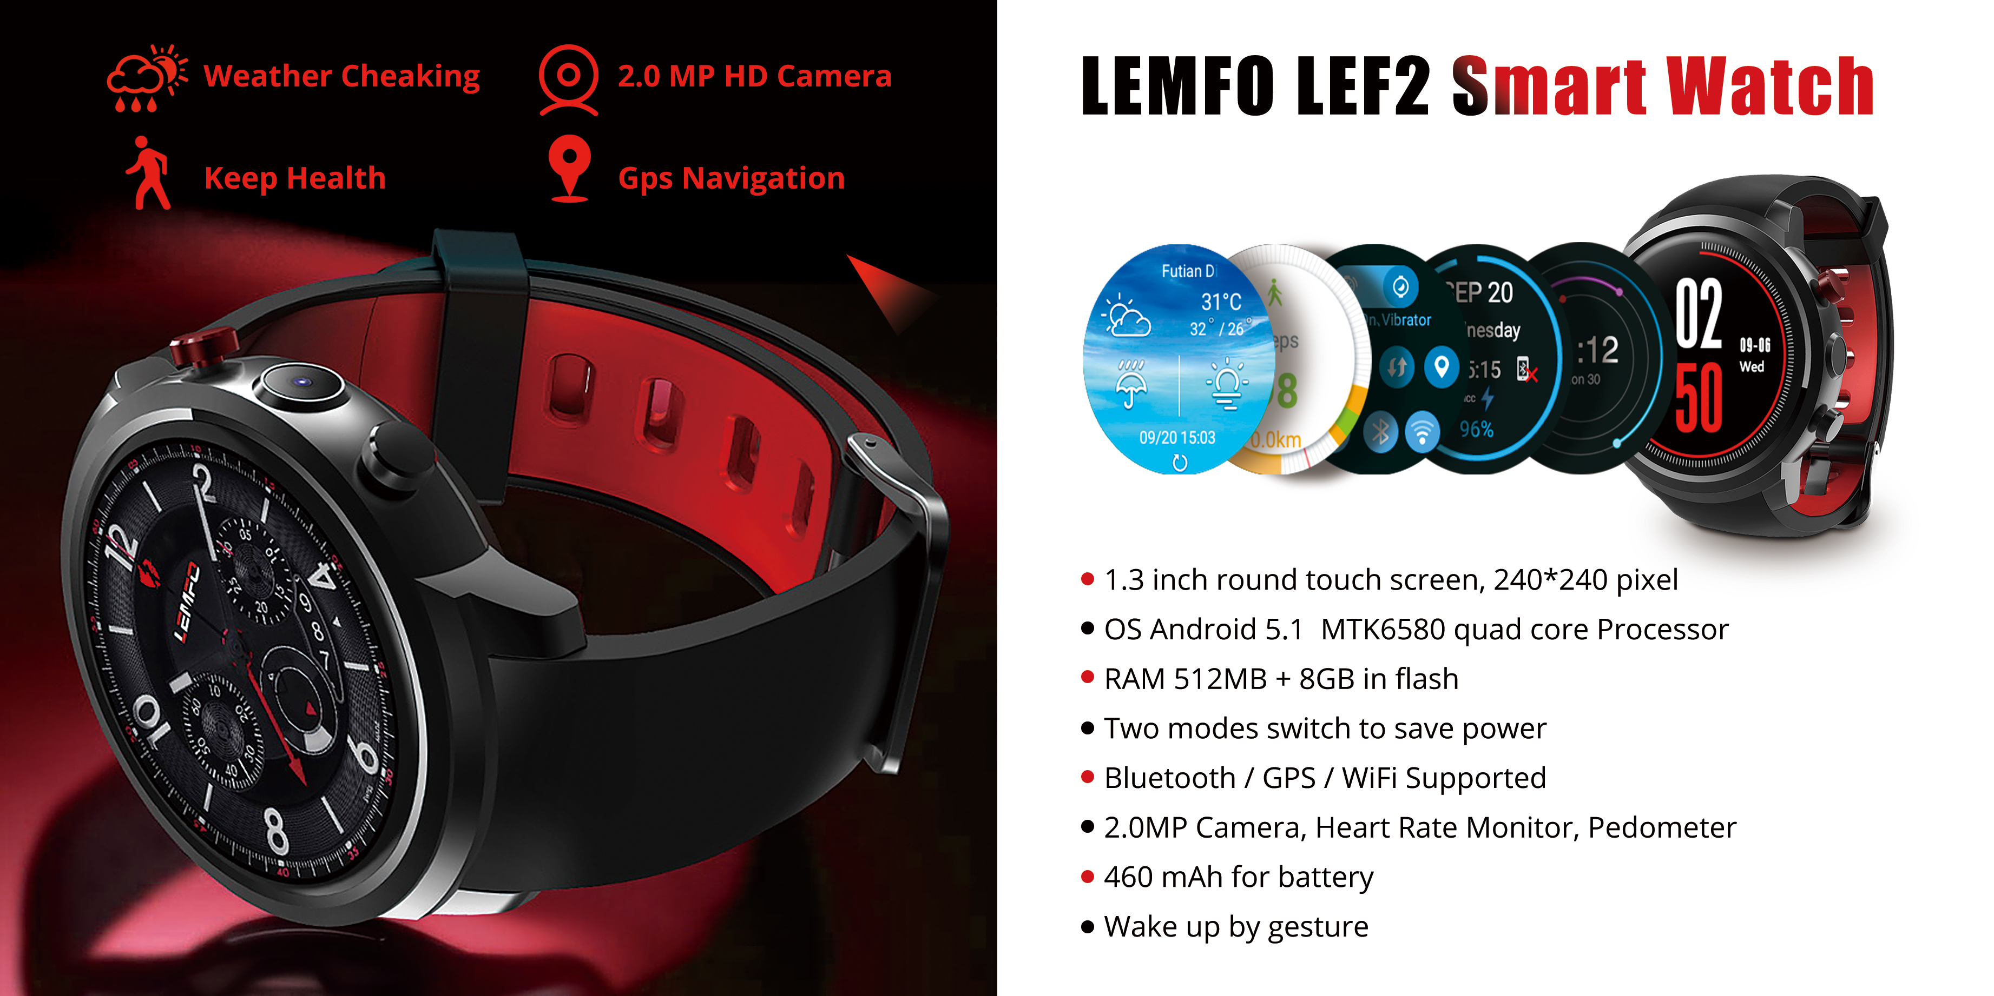
LEMFO SMART

Slide 8
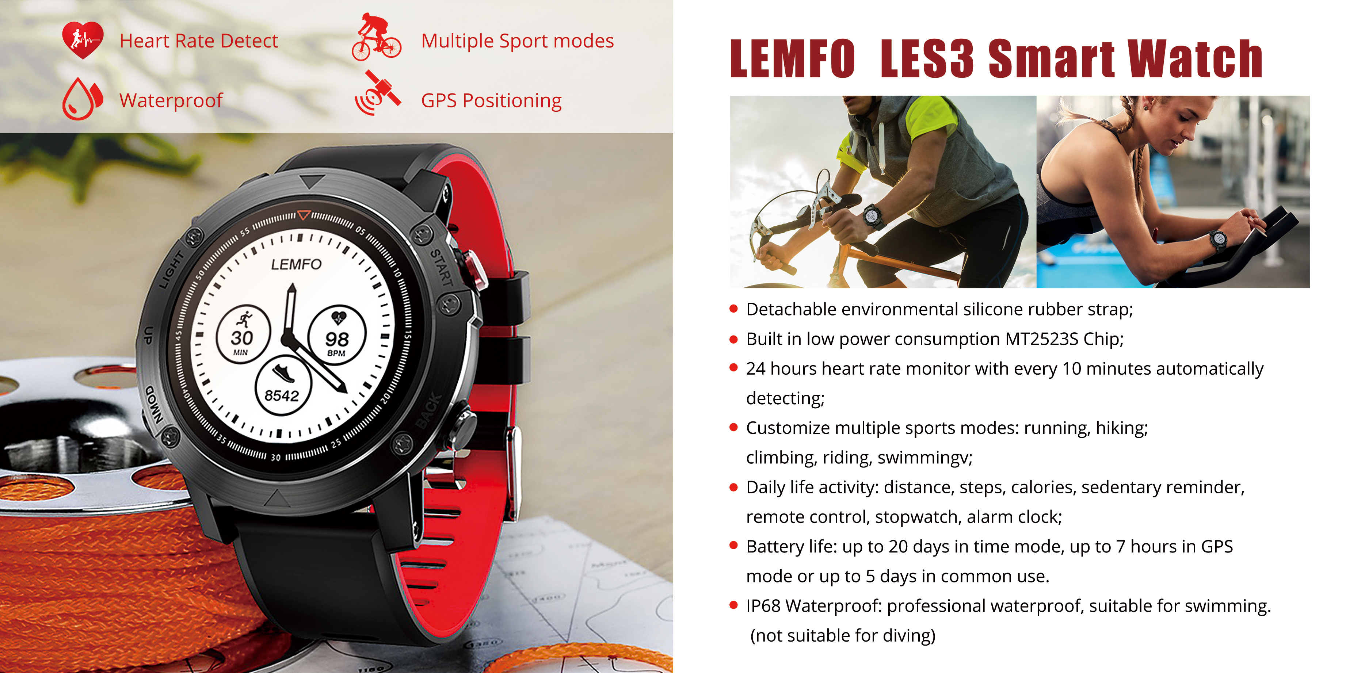
LEMFO SMART

Slide 9
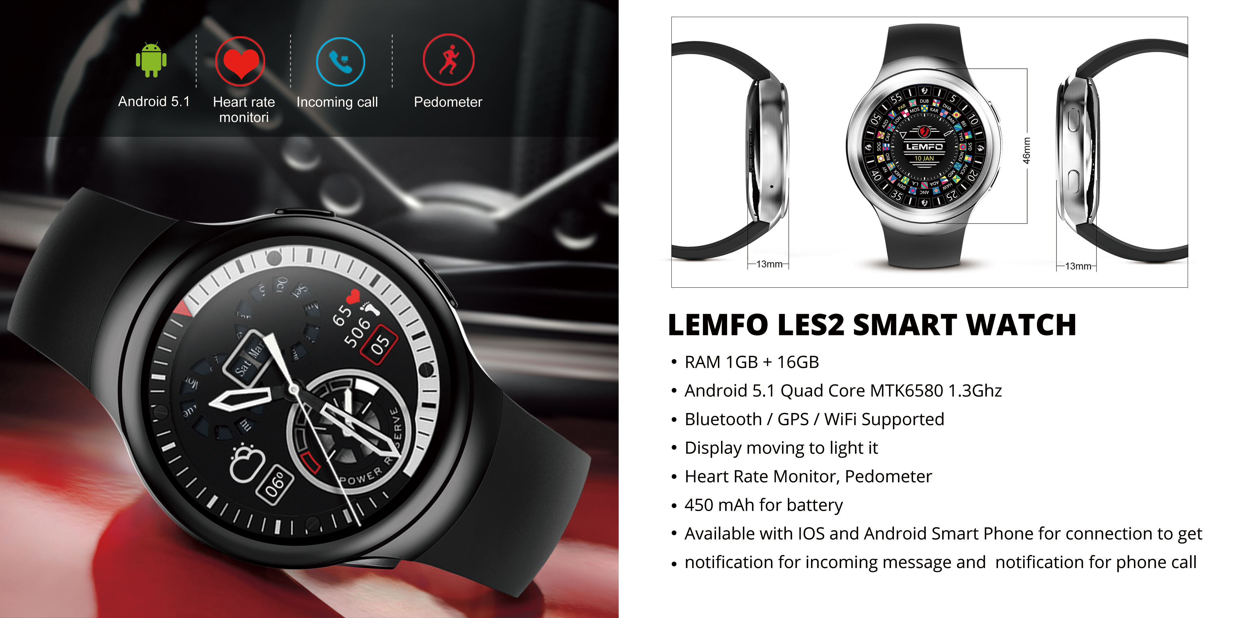
LEMFO SMART

Slide 10
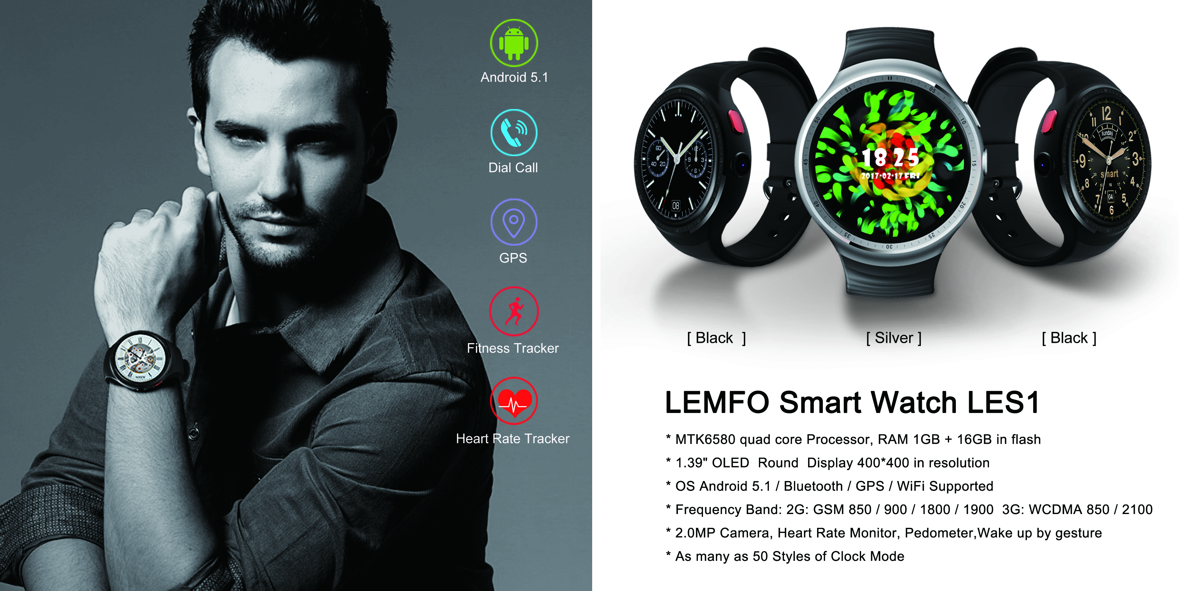
LEMFO SMART

Slide 11
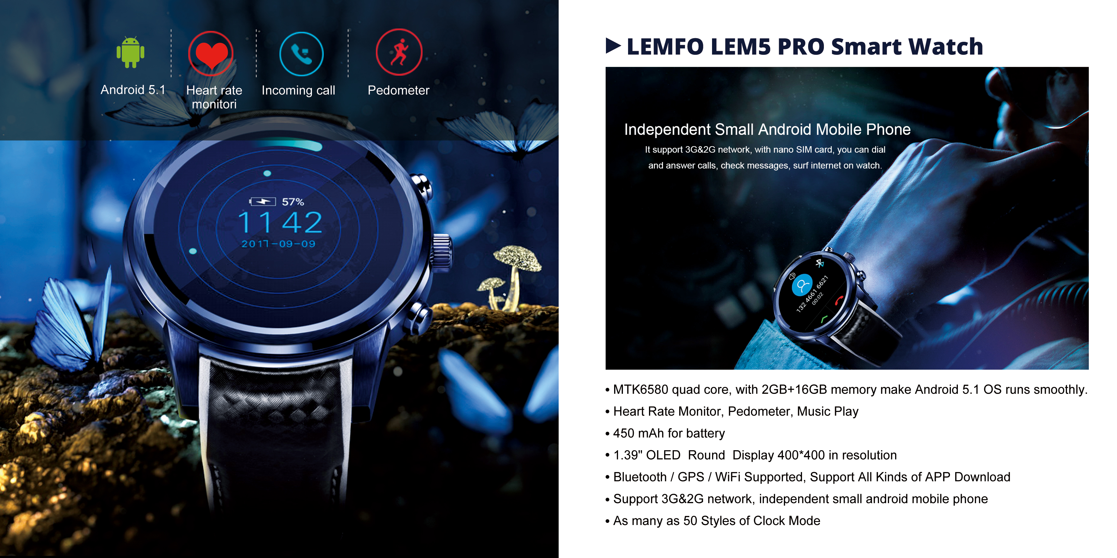
LEMFO SMART

Slide 12
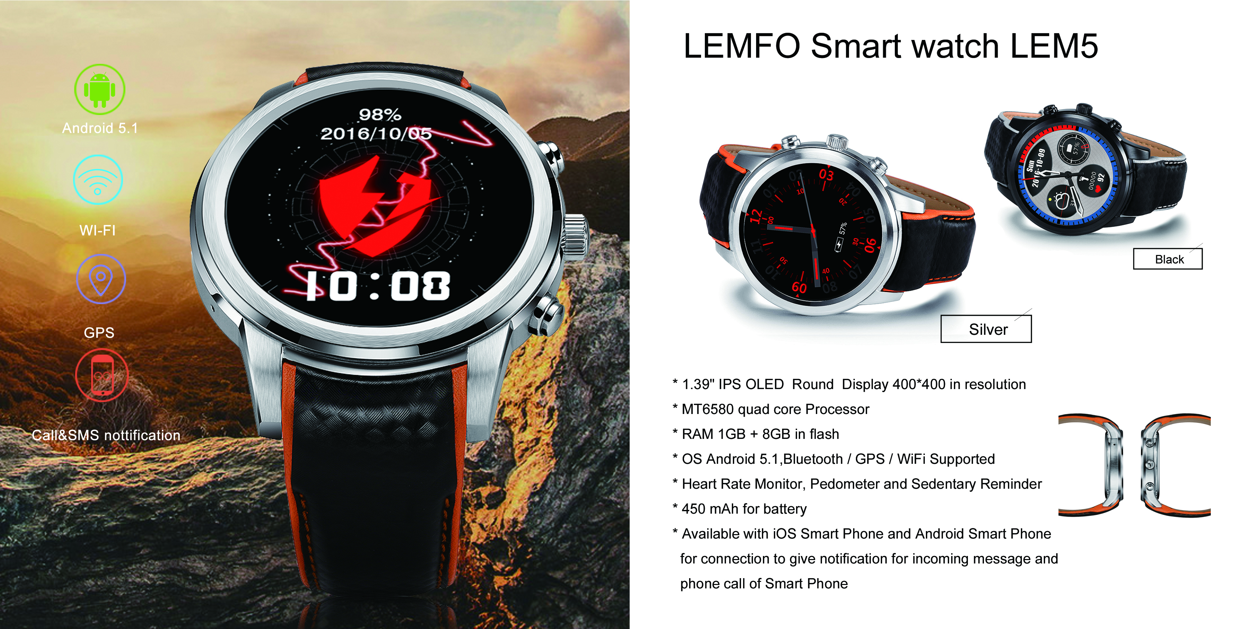
LEMFO SMART

Slide 13
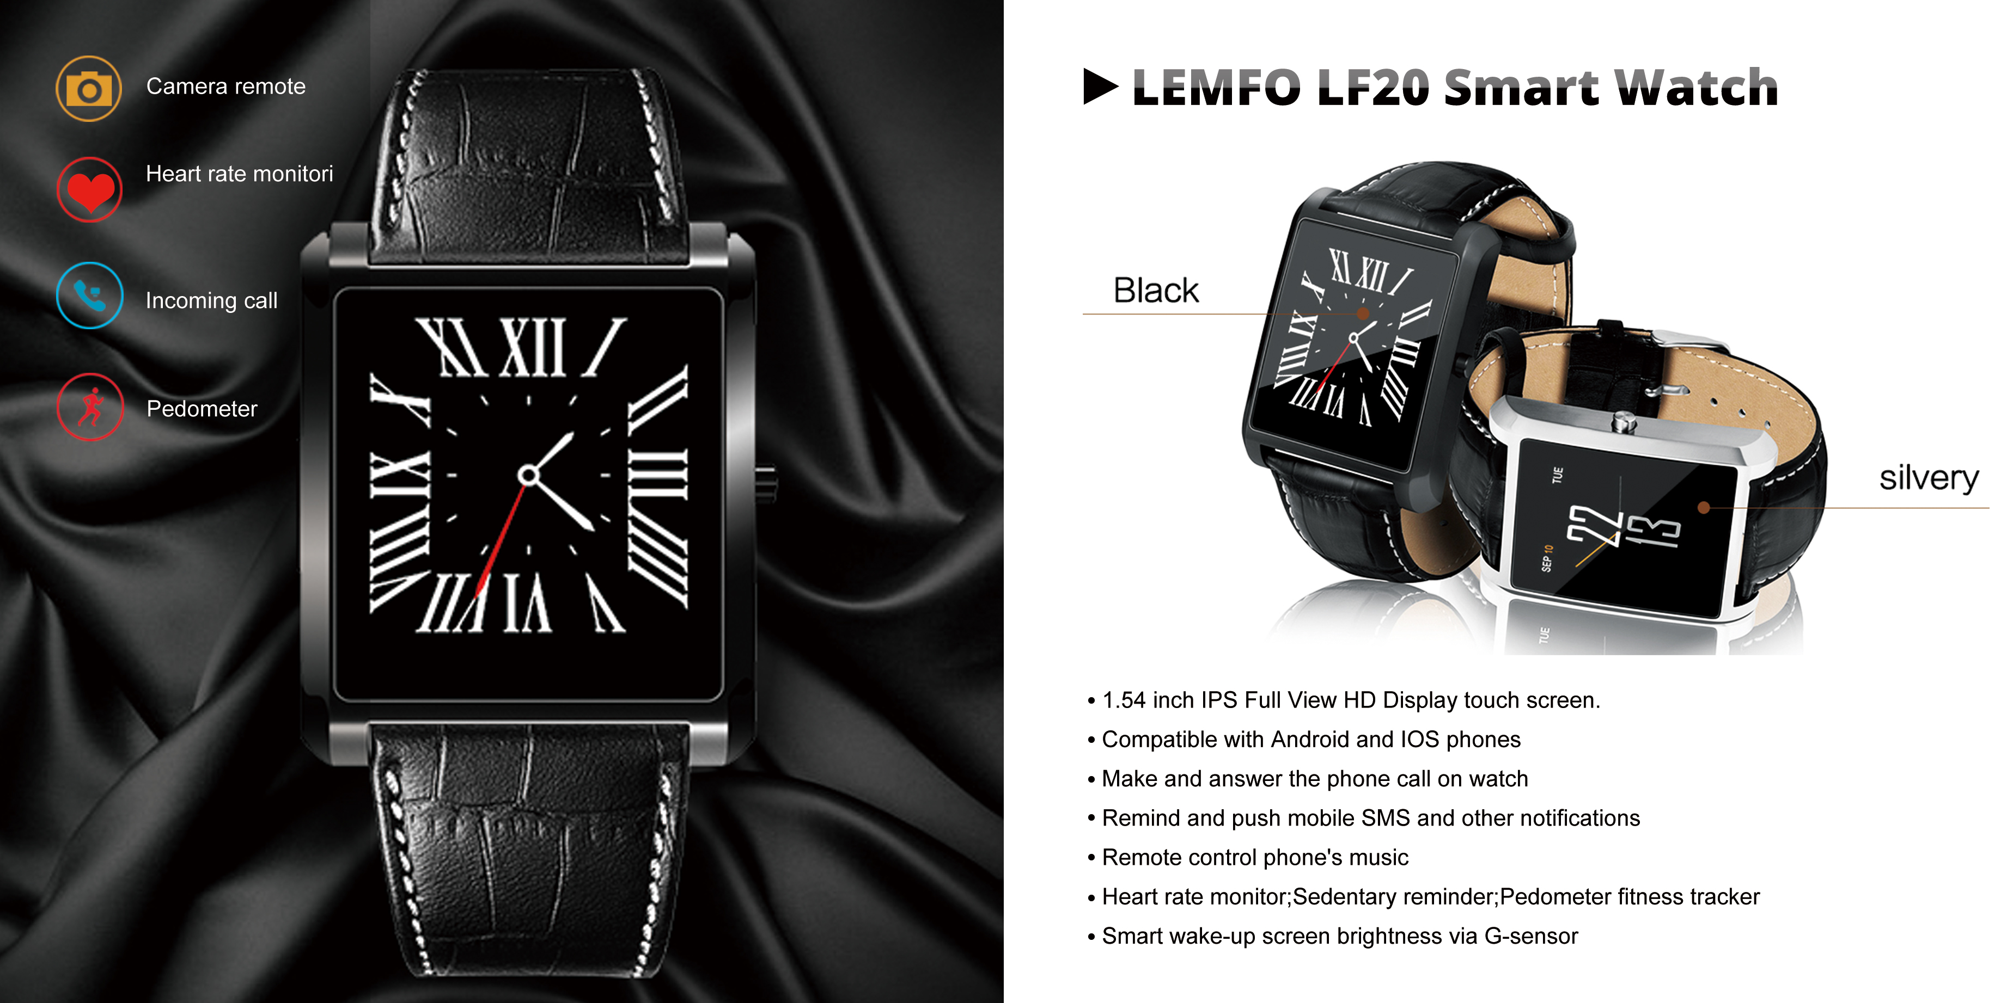
LEMFO SMART

Slide 14
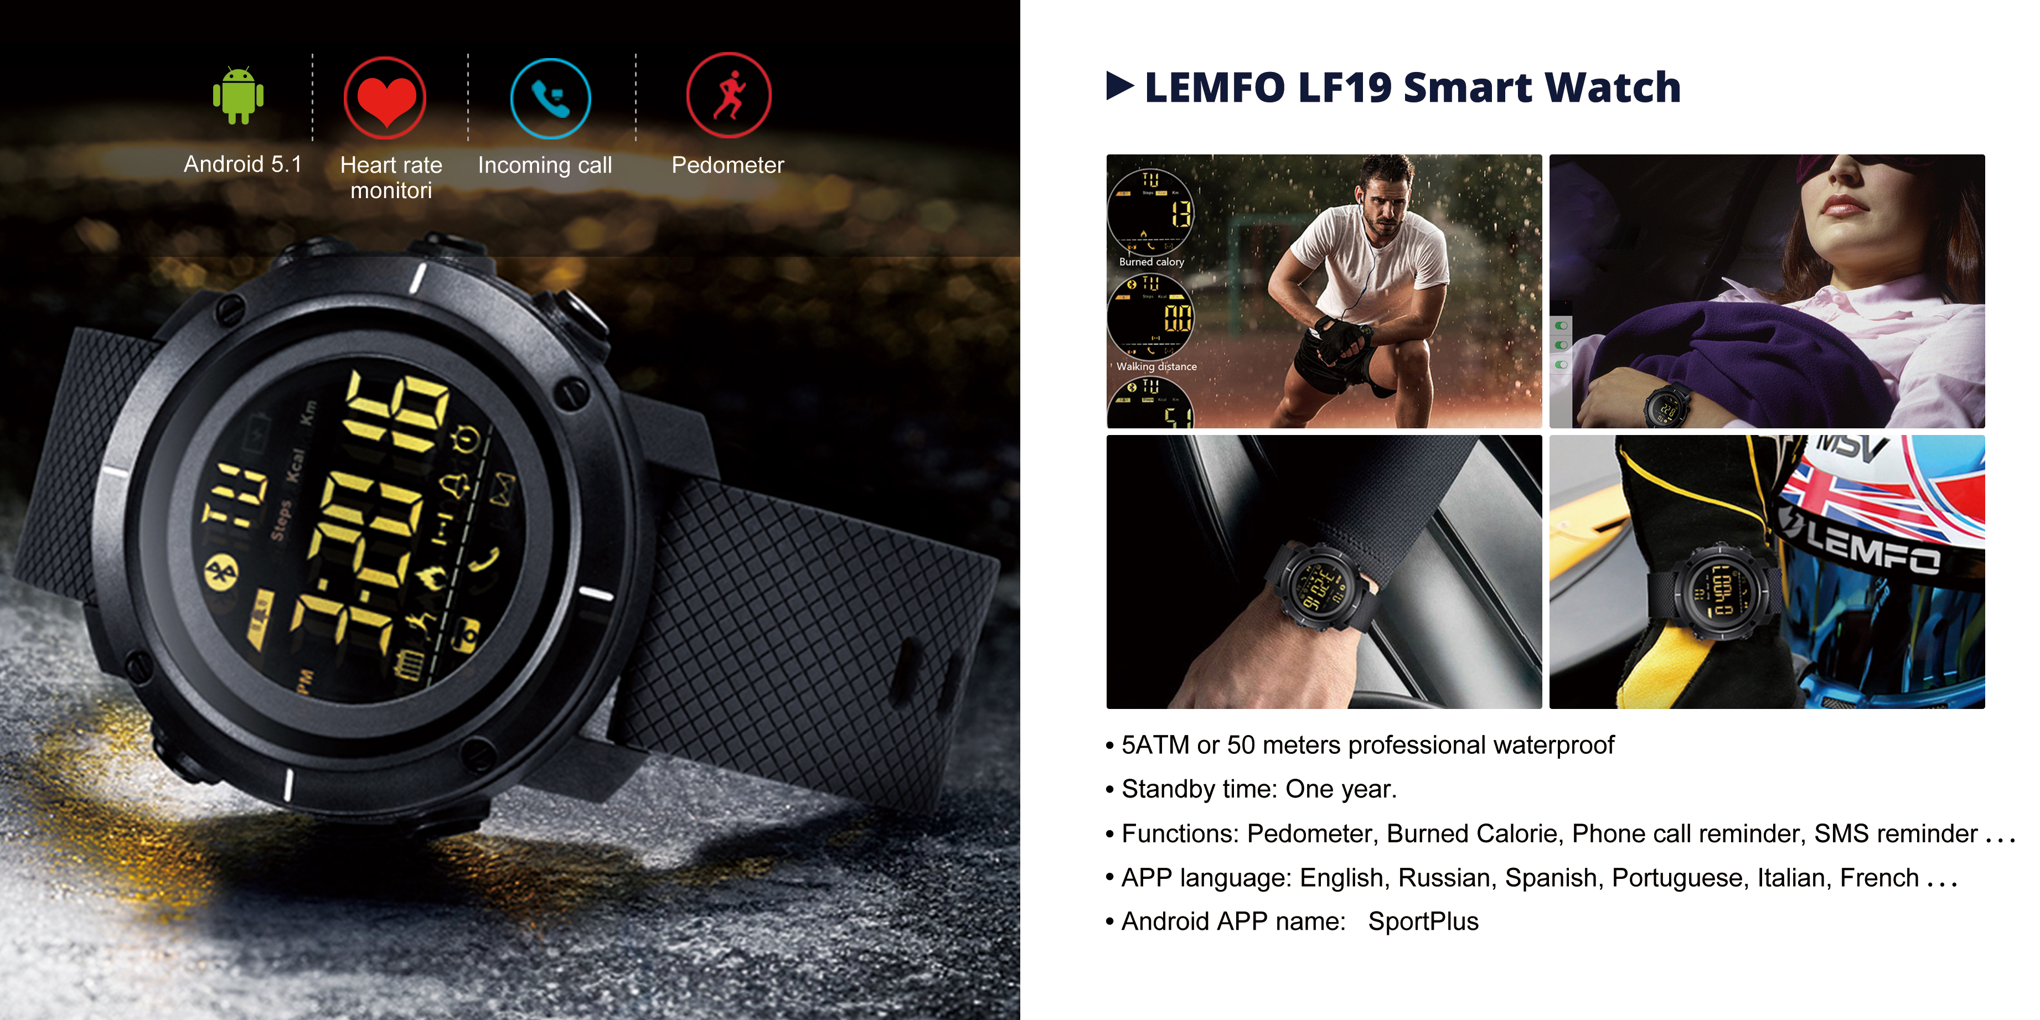
LEMFO SMART

Slide 15
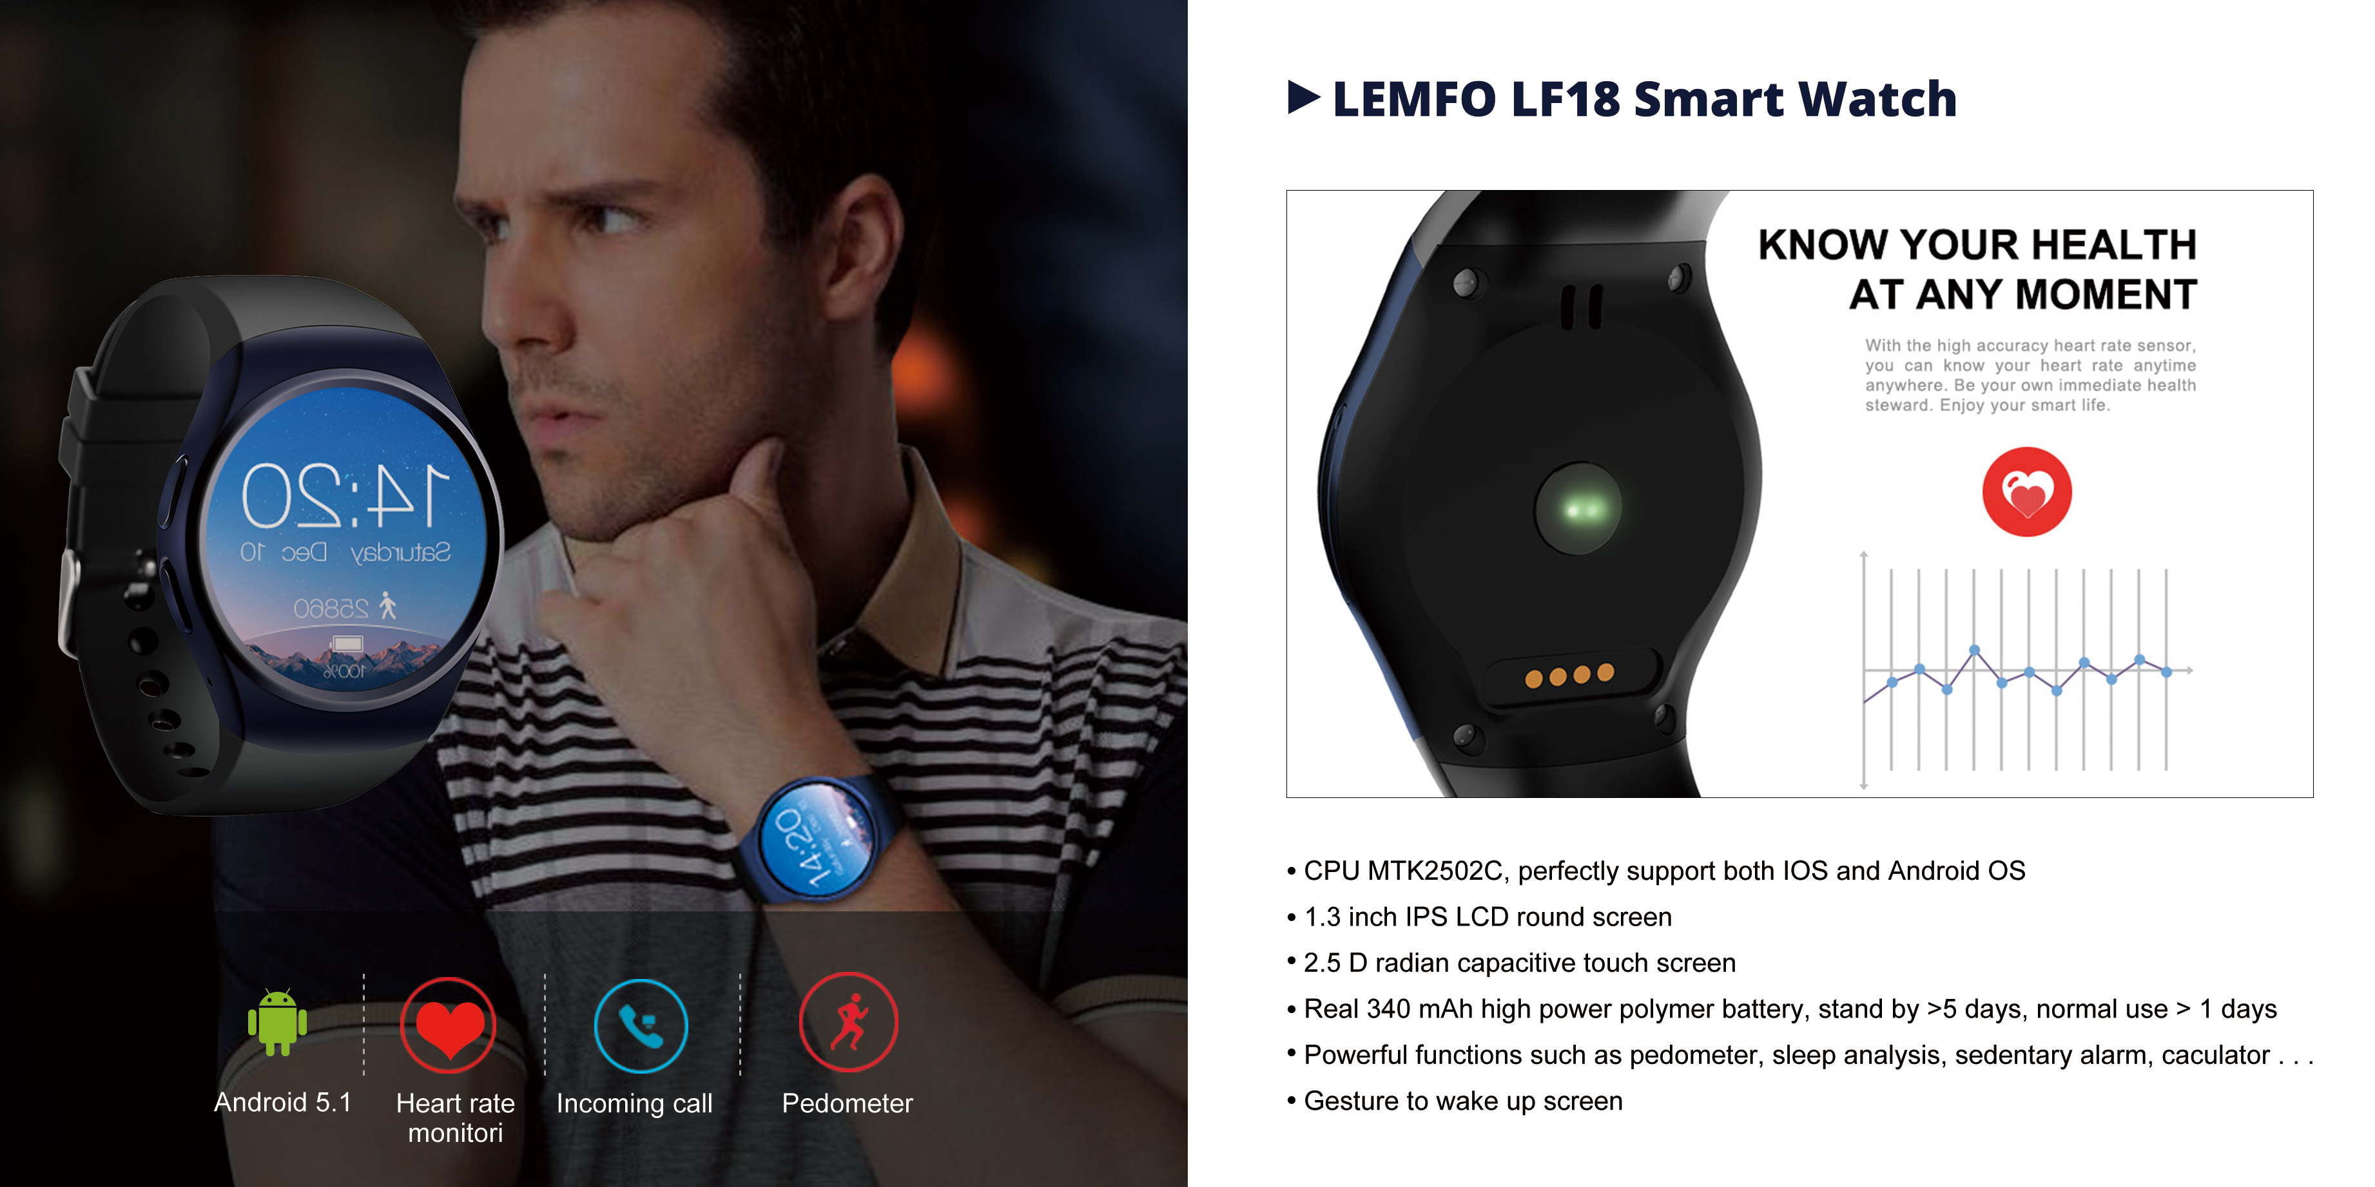
LEMFO SMART

Slide 16
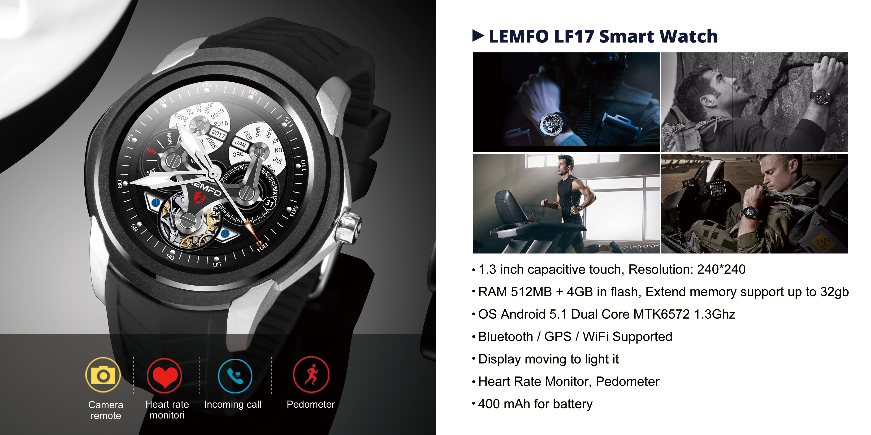
LEMFO SMART

